Slide 1

Setting Up User Accounts
NATIONAL INSTITUTE OF ELECTRONICS AND INFORMATION TECHNOLOGY
Machine Learning Using Python
Day 12

Slide 2
Machine Learning
x1 (Input) | y (Output)
2 | 4
3 | 6
4 | 8
5 | 10
6 | 12
7 | 14
8 | 16
y = 2 multiplied by x1

Slide 3
What kind of problem Machine Learning can solve:
Machine Learning Algorithm
(Fit Function)
Training Input (X)
Machine Learning Model
(X y)
Training Output(y)
Machine Learning Model
(Predict)
Output
(y)
New Input (X)

Slide 4
Plot between CGPA and chance of admission
import matplotlib.pyplot as plt
plt.scatter(df[‘CGPA'],df[‘Chance of Admit'])
plt.title("CGPA vs Chance of Admit")
plt.xlabel(“CGPA")
plt.ylabel(“Chance of Admit")
plt.show()

Slide 5
Linear Regression
y=ax+b – relationship-model
Where a is coefficient and
b is intercept.
x=independent variable=CGPA
y=dependent variable=Chance of Admit

Slide 6
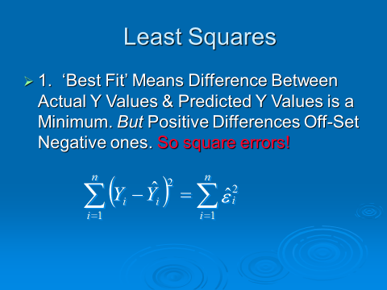

Slide 7
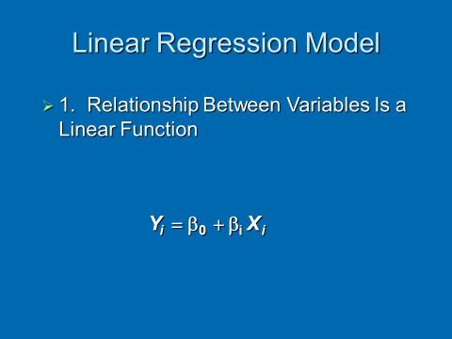

Slide 9
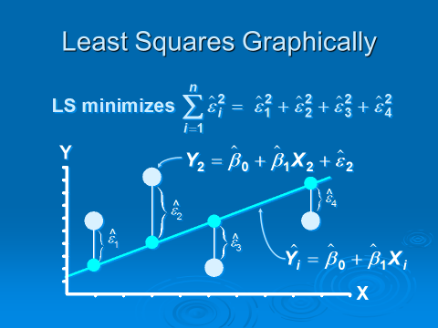

Slide 10
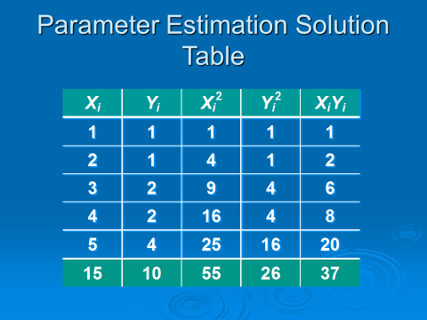

Slide 11
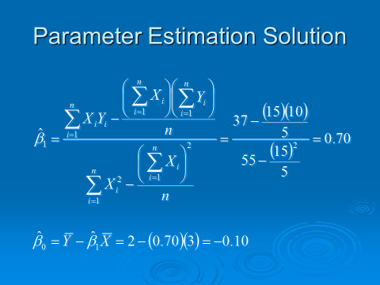
Parameter Estimation Solution
Notes:
59

Slide 12
>>> m.coef_
>>> m.intercept_
Notes:
59

Slide 13
Score
The coefficient R^2 is defined as (1 - u/v),
where u is the residual sum of squares
((y_true - y_pred) ** 2).sum()
and v is
((y_true - y_true.mean()) ** 2).sum().
The best possible score is 1.0
and it can be negative
(because the model can be arbitrarily worse).
Notes:
59

